Slide 1
Acknowledgements
We would like to express our deep gratitude and sincere thanks to all who helped us in completing this project report successfully. Many thanks to almighty God who gave us the strength to do this. Our sincere thanks to Principal Prof. Dr. Girish. K. Patnaik for providing the facilities to complete this Project report. We would like to express our gratitude and appreciation to all those who gave us the possibility to complete this report. A special thanks to Prof. Dr. Krishnakant P. Adhiya, Head of the Department, whose help, stimulating suggestions and encouragement, helped us in writing this report. We would also like to thank (Name of the Guide), Project Guide, who has given his/her full effort in guiding us and achieving the goal as well as his encouragement to maintain the progress in track. I am also sincerely thankful to Mr. Ashish Bhole, Incharge of Project, for his valuable suggestions and guidance. We would also like to appreciate the guidance given by other supervisor that has improved our presentation skills by their comments and tips. Last but not the least, we are extremely thankful to our parents and friends without whom it could not reach its successful completion.
1. Rohit Sonawane
2. Sakshi Mahajan
3. Chetan Mahajan
4. Vaishnavi Gadhe

Slide 2
Title
DETECTION OF PHISHING WEBSITES USING MACHINE LEARNING

Slide 4
ABSTRACT
Phishing costs Internet users billions of dollars per year. It refers to luring techniques used by identity thieves to fish for personal information in a pond of unsuspecting internet users. Phishers use spoofed e-mail, phishing software to steal personal information and financial account details such as usernames and passwords. The malicious links within the body of the message are designed to make it appear that they go to the spoofed organization using that organization’s logos and other legitimate contents.This paper deals with methods for detecting phishing web sites by Natural Language Processing and by Machine learning techniques. Machine learning is a powerful tool used to strive against phishing attacks.
We discuss the methods used for detection of phishing websites based on NLTK libraries such as word segmentation, stemming and lemmatization(methods of trimming words down to their roots), and tokenization(for breaking phrases, sentences and paragraph into tokens that help computer to better understand text) The fine-tuned parameters are useful in selecting the apt machine learning algorithm for classifying the phishing sites and benign sites. We’ve classified them into ‘Good’ sites and ‘Bad’ sites.

Slide 5
PROBLEM STATEMENT
URLs sometimes known as “Web links” are the primary means by which users locate information in the Internet. Aim of the phishers is to acquire critical information like username, password and bank account details. Our aim is to derive classification models that detect phishing urls using MACHINE LEARNING and NATURAL LANGUAGE PROCESSING. In Jupyter environment.
From many years and still people are suffering from phishing attacks. One constant form of phishing is sending fraud urls to peoples and then asked them to click on a link that takes them to an imposter website or to a site infected with malware. It mostly comes in the form of email.
The unchanging strategy of phishers is They usually “warn” you that your “account is in danger,” or that you “need to change your password immediately.” Some phishing emails are allegedly from a Nigerian price that is asking for you help. Or, any one of thousands of other scams.

Slide 6
LITERATURE SURVEY
S. Marchal et al., (2017) proposed this technique to differentiate Phishing website depends on the examination of authentic site server log knowledge. An application Off-the Hook application or identification of phishing website. Free, displays a couple of outstanding properties together with high preciseness, whole autonomy, and nice language-freedom, speed of selection, flexibility to dynamic phish and flexibility to advancement in phishing ways.
Mustafa Aydin et al. proposed a classification algorithm for phishing website detection by extracting websites' URL features and analyzing subset based feature selection methods. It implements feature extraction and selection methods for the detection of phishing websites. The extracted features about the URL of the pages and composed feature matrix are categorized into five different analyses as Alpha numeric Character Analysis, Keyword Analysis, Security Analysis, Domain Identity Analysis and Rank Based Analysis. Most of these features are the textual properties of the URL itself and others based on third parties services.
Samuel Marchal et al. presents PhishStorm, an automated phishing detection system that can analyze in real time any URL in order to identify potential phishing sites. Phish storm is proposed as an automated real-time URL phishingness rating system to protect users against phishing content. PhishStorm provides phishingness score for URL and can act as a Website reputation rating system.

Slide 7
ANALYSIS
PROJECT DESCRIPTION
We have developed our project using a website as a platform for all the users. This is an interactive and responsive website that will be used to detect whether a website is legitimate or phishing. This website is made using different web designing languages which include HTML, CSS, and Flask. The basic structure of the website is made with the help of HTML. CSS is used to add effects to the website and make it more attractive and user-friendly. To deploy our machine learning model we have used flask framework. User can see whether the url they entered is ‘Good’ or ‘Bad’.
The website shows information regarding the services provided by us. It also contains information regarding illpractices occurring in today’s technological world. The website is created with an opinion such that people are not only able to distinguish between legitimate and fraudulent website, but also become aware of the mal-practices occurring in current world. They can stay away from the people trying to exploit one’s personal information, like email address, password, debit card numbers, credit card details, CVV, bank account numbers, and the list goes on.

Slide 8
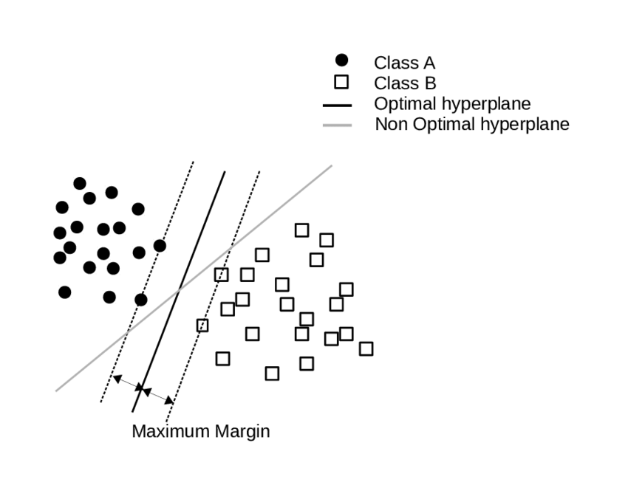
WORKFLOW AND DESIGN
• Firstly we have checked whether there is any null value present in the dataset or not and if so removed it.
• Use of RegexpTokenizer : with the help of tokenize.regexp() module, we are able to extract the tokens from strings by using regular expression with RegexpTokenizer() method.
• Use of PorterStemmer : stemmer is used to produce morphological variants of a root/base word. Stemming is desirable as it may reduce redundancy as most of the time the word stem and their derived words mean the same. And then after stemming joining of words is done.
• Feature Extraction using TfidfVectorizer: It’s the main part of natural language processing . TF-IDF is an abbreviation for Term Frequency Inverse Document Frequency. This is very common algorithm to transform text into a meaningful representation of numbers which is used to fit machine algorithm for prediction.
• Splitting the data: Train-test-split is used to split the data into training dataset and testing dataset.
• Algorithms used: Support Vector Machine (SVM) is used. The SVM performs classification by finding the hyper plane that maximizes the margin between two classes. The vectors that define the hyper plane are the support vectors. Below is the figure showing how it works?

Slide 9
DATASET ANALYSIS, FEATURES AND SRS
Dataset is collected from Kaggle.
Dataset contains 5,49,346 unique entries.
There are two columns.
Label column is a prediction column which has 2 categories.
I. Good : means site is not phishing.
II. Bad: means site is phishing.
Software requirements specification (SRS)
Hardware Requirements:-
2GB RAM (minimum)
100GB HDD (minimum)
Intel 1.66 GHz Processor Pentium 4 (minimum)
Internet Connectivity
Software Requirements:-
WINDOWS 7 or higher
Python 3.6.0 or higher
Visual Studio Code
Flask
HTML
Dataset of Phishing Website

Slide 10
WORKFLOW AND DESIGN (CONT.)
• Dumping of model using pickle: Python pickle module is used for serialising and de-serialising a Python object structure. Any object in Python can be pickled so that it can be saved on disk. What pickle does is that it “serialises” the object first before writing it to file. Pickling is a way to convert a python object (list, dict, etc.) into a character stream. The idea is that this character stream contains all the information necessary to reconstruct the object in another python script.
• Deploy model using Flask on web page: This is the last step of project. After deployment, other end users can make use of it.
• BLOCK DIAGRAM OF WORKFLOW
Data preprocessing
Tokenization and stemming
Feature extraction
Pipeline building and loading the model into pickle
Fitting the model with SVM

Slide 11
UML DIAGRAM
Visualization of model
Tokenization
Data preprocessing
Feature
Extraction
Vectorization
Fitting the model in SVM
Pipeline build
Start
Stemming
Predict output
Good
Bad

Slide 12
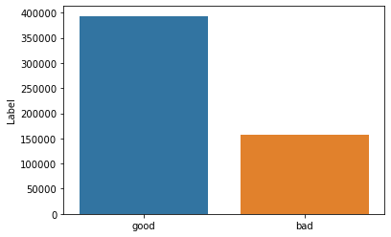
RESULTS
Scikit-learn tool has been used to import Machine learning algorithms. Each classifier is trained using training set and testing set is used to evaluate performance of classifiers.
Performance of classifiers has been evaluated by calculating classifier's accuracy score.
Fig 2. Barplot showing count of Good and Bad values in the dataset
• Here we got model accuracy of 97% which is quite good.
So Support Vector Machine is ideal to use.
Fig 2.1. Classifier report
Classifier | Accuracy Rate% | Error Rate%
SVM | Training-99% Testing-97% | 3%

Slide 13
CONCLUSION & REFERENCES
CONCLUSION
To summarize, we have seen how phishing is a huge threat to the security and safety of the web and how phishing detection is an important problem domain. We have tested SVM machine learning algorithm on the ‘Phishing Websites Dataset’ and reviewed their results. We then built a Chrome extension for detecting phishing web pages. The extension allows easy deployment of our phishing detection model to end users. We have detected phishing websites using Support Vector Machine with and accuracy of 97.94%.
For future enhancements, we intend to build the phishing detection system as a scalable web service which will incorporate online learning so that new phishing attack patterns can easily be learned and improve the accuracy of our models with better feature extraction.
REFERENCES
Detection of phishing websites using machine learning International Journal of Engineering Research & Technology (IJERT) http://www.ijert.org ISSN: 2278-0181 IJERTV10IS050235 (This work is licensed under a Creative Commons Attribution 4.0 International License.) Published by : www.ijert.org Vol. 10 Issue 05, May-2021
Joby James, Sandhya L, Ciza Thomas Detection of phishing websites using machine learning techniques. 2013 International Conference on Control Communication and Computing (ICCC)https://www.researchgate.net/publication/269032183
Mustafa AYDIN, Nazife BAYKAL (2015) Feature extraction and classification phishing websites based on URL. IEEE

Slide 14
THANK YOU!

